Slide 1

_{APEX INSTITUTE OF TECHNOLOGY}
DEPARTMENT OF COMPUTER SCIENCE & ENGINEERING
Database Management System (22CSH-243)
_{Faculty: Ms. Shaveta Jain} _{(E13464)}
_{Conditional Control Structure}
_{DISCOVER . LEARN . EMPOWER}

Slide 2
DBMS: Course Objectives
_{COURSE OBJECTIVES}
_{The Course aims to:}
Understand database system concepts and design databases for different applications and to acquire the knowledge on DBMS and RDBMS.
Implement and understand different types of DDL, DML and DCL statements.
Understand transaction concepts related to databases and recovery/backup techniques required for the proper storage of data.

Slide 3
COURSE OUTCOMES
On completion of this course, the students shall be able to:-
CO3 | Apply relational algebra and relational calculus to query the database of organization

Slide 4
Lecture Outline
Control Structures of PL/SQL
Loops
Nested Loops
For
While

Slide 5
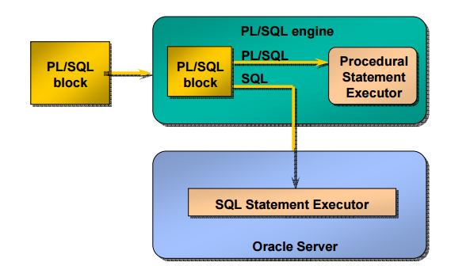
Structure of PL/SQL

Slide 6
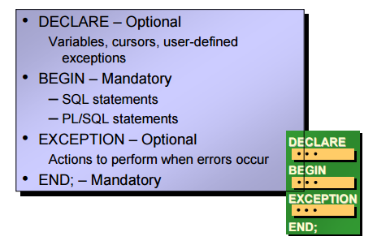
Structure of PL/SQL

Slide 7
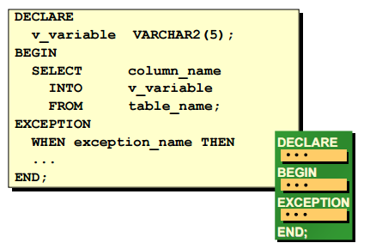
Example for Structure of PL/SQL

Slide 8
Example for Structure of PL/SQL
DECLARE
a number;
text1 varchar2(20);
text2 varchar2(20) := “HI”;
BEGIN
DBMS_OUTPUT.PUT_LINE(text2) ;
---------- ---------- ----------;
END;

Slide 9
DBMS_OUTPUT.PUT_LINE(text2)
It prints Message and value of variable
Package: Dbms_Output
Procedure: Put_Line()

Slide 10
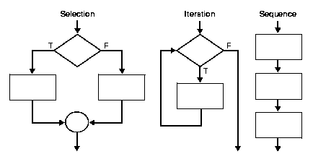
PL/SQL Control Structure
PL/SQL has a number of control structures which includes:
Conditional controls
Iterative or loop controls.
It is these controls, used singly or together, that allow the PL/SQL developer to direct the flow of execution through the program.

Slide 11
PL/SQL Control Structure: Conditional Controls
Conditional Controls
IF....THEN....END IF;
IF....THEN...ELSE....END IF;
IF....THEN...ELSIF....THEN....ELSE....END IF;

Slide 12
IF THEN ELSE STATEMENT:
1)
IF condition THEN
Statement 1;
ELSE
Statement 2;
END IF;
2)
IF condition 1 THEN
Statement 1;
Statement 2;
ELSIF condtion2 THEN
Statement 3;
ELSE
Statement 4;
END IF

Slide 13
Write PL/SQL code for finding Even Numbers.
BEGIN
FOR I IN 1..100 LOOP
IF MOD(I,2)=0 THEN
DBMS_OUTPUT.PUT_LINE(I);
END IF;
END LOOP;
END;
/

Slide 14
//Write PL/SQL code to find Largest of three numbers.
DECLARE
A NUMBER;
B NUMBER;
C NUMBER;
BEGIN
A:=&A;
B:=&B;
C:=&C;
IF A=B AND B=C AND C=A THEN
DBMS_OUTPUT.PUT_LINE('ALL ARE EQUAL');
ELSE IF A>B AND A>C THEN
DBMS_OUTPUT.PUT_LINE('A IS GREATER');
ELSE IF B>C THEN
DBMS_OUTPUT.PUT_LINE('B IS GREATER');
ELSE
DBMS_OUTPUT.PUT_LINE('C IS GREATER');
END IF;
END IF;
END IF;
END;/

Slide 15
References
RamezElmasri and Shamkant B. Navathe, “Fundamentals of Database System”, The Benjamin / Cummings Publishing Co.
Korth and Silberschatz Abraham, “Database System Concepts”, McGraw Hall.
C.J.Date, “An Introduction to Database Systems”, Addison Wesley.
Thomas M. Connolly, Carolyn & E. Begg, “Database Systems: A Practical Approach to Design, Implementation and Management”, 5/E, University of Paisley, Addison-Wesley.

Slide 16
THANK YOU
For queries
Email: shaveta.e13464@cumail.in

